Slide 1



Executable TSG with Notebooks for SQL People
C# Corner - SQL Server Virtual Conference 2021 (Jan 29, 2021)
Julie Koesmarno (@MsSQLGirl)
Program Manager, Microsoft
jukoesma@microsoft.com
Aaron Nelson (@SQLVariant)
Senior Consultant, Microsoft
Aaron.Nelson@microsoft.com

Slide 2

Our learning journey today
1
Intro to TSG & Notebooks
2
Executable TSGs with Notebooks
3
Jumpstart your TSG notebooks
4
Call to action & resources

Slide 3

1 Intro to TSGs & Notebooks

Slide 4

“TSG”
TSG = Troubleshooting Guide
SOP = Standard Operating Procedure
Playbook = steps to identify issues
Runbook = procedures to achieve specific outcome
KB = Knowledge Base
Incident Response

Slide 5

Before you run ~ (sharing lessons learned)

Slide 6
Don’t forget …
change agent process
1. Know your goals
2. Understand the gaps
3. Plan it!

Slide 7
Demo Notebooks in Azure Data Studio

Slide 8
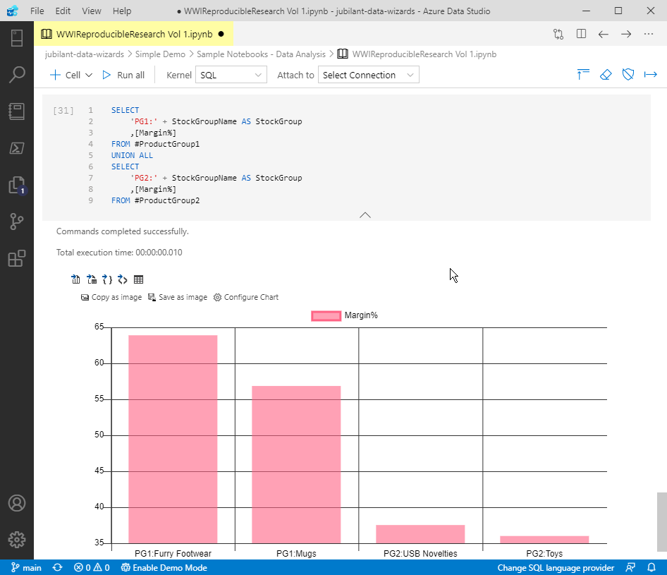
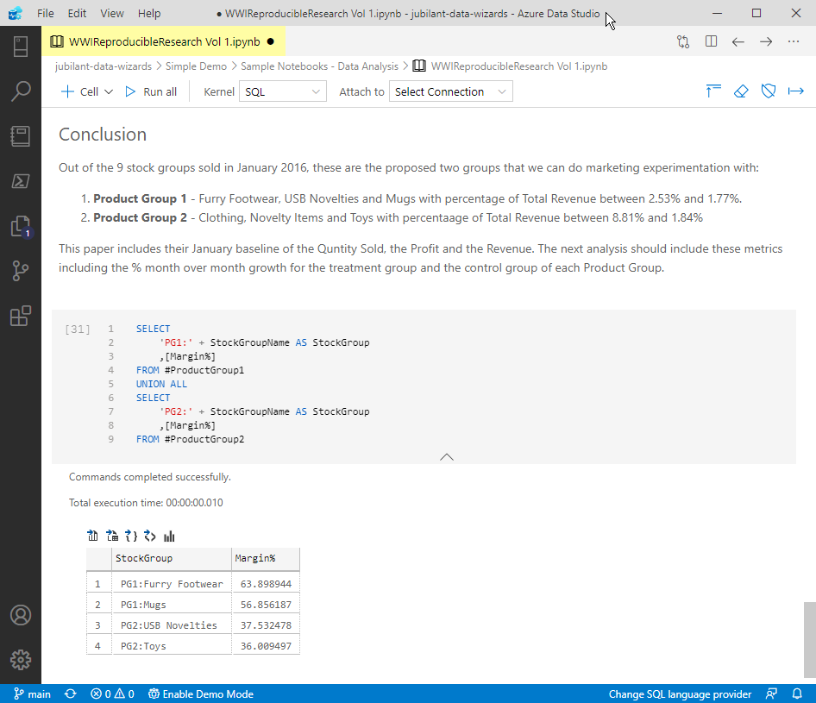
Notebooks
Text cells
Code cells
SQL
PowerShell
Python
KQL
.NET interactive
Jupyter Book

Slide 9


Azure Data Studio
Modern data experiences, multi data-platforms SQL: SQL Server, PostgreSQL, Azure SQL Edge, Azure SQL* KQL: Azure Data Explorer Environment: On-premises, poly-cloud
Client tool on multi-platforms: Windows, Linux, macOS
Extensible tool
Git support
Jupyter Notebook experiences
… and more …

Slide 10
2 Executable TSGs

Slide 11
Demo TSG with PowerShell Notebooks
Notes:
Invoke-ExecuteNotebook
SOP - Export Power BI workspace
TSG on Query perf troubleshooting

Slide 12

Troubleshooting Guides in the closet!
Challenges:
Static text in OneNote / wiki resulting in copy and paste
Discoverability - siloed TSG scripts
No version control to keep track quality
Sharing code and results with context is hard to do with OneNote or text files
Hard to crowd source code
Hard to search
Lack of availability on secure / airgap environment

Slide 13
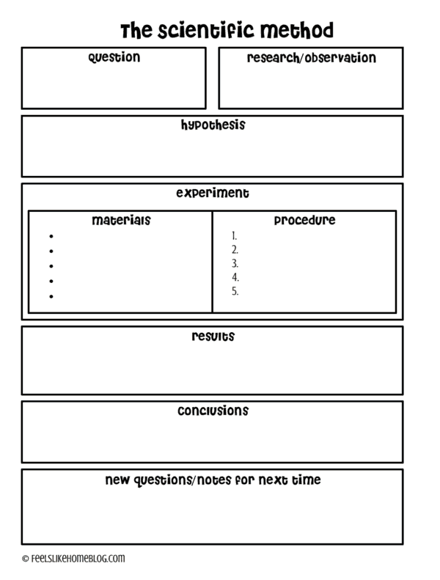

remember School Science Projects?
Error Message
Symptoms
Proposed mitigation
Mitigation Scripts, Actions, Environment Details
Very similar to TSG!
Mitigation Output
Notebook was born from data science
Interpretation of output
Source: https://feelslikehomeblog.com/2017/07/the-science-of-slime-its-way-more-than-polymers/

Slide 14
Demo TSGs by / for the SQL community

Slide 15
3 Jumpstart your TSG Notebooks

Slide 16

Jump start to Notebooks!
Bulk conversions -
OneNote to Notebooks*
SQL Scripts to Notebooks with ConvertTo-SqlNoteBook
PowerShell scripts to Notebooks with ConvertTo-PowerShellNotebook
Individual conversions -
Export as Notebook UI in Azure Data Studio from a SQL Script
PowerShell history to a Notebook Get-History 7,14 | % comm* | Export-AsPowerShellNotebook -OutputNotebook d:\temp\testthis.ipynb

Slide 17
Quick Tips
Organize TSG Notebooks as Books / Jupyter books
Use Source Control – TSGs are now engineering artefacts
Use Azure Data Studio
Remember the “before you run” Know your goals, understand the gaps, plan it.
Check other executable TSGs for inspiration
Set guidance / template on TSG
Pilot, learn and iterate your TSG changes

Slide 18
4 Where to go from here

Slide 19






Incident Response Flow & Ecosystem with Notebooks
System Event / User Reported Incident
Use existing notebooks
Create new notebooks
Add reusable notebook
Rate existing notebooks
Log adhoc notebook in incident system
Update notebook if necessary
Automate
Incident Response System
Investigate & Mitigate
Use Notebook as the incident’s audit trail
Post Mortem
Analyze and enrich Troubleshooting Repo
Troubleshooting Notebook Repo

Slide 20
Takeaways
Notebooks are very useful for Operational / Live site / on-call use cases.
Data community is embracing Notebooks for Operational workflows.
To jumpstart your Notebook conversion, use existing tools. You’ll still need to tidy up~
TSGs examples for community: SQL Server 2019 Big Data cluster, SQL Server Diagnostic Queries Book, and more.
Azure Data Studio provides modern data experiences, for your development to troubleshooting.

Slide 21
Don’t forget …
1. Know your goals
2. Understand the gaps
3. Plan it!

Slide 22
Useful resources
http://aka.ms/AzureDataStudio | Sample files: https://bit.ly/2YGTpAy https://github.com/microsoft/azuredatastudio/issues
Tiger Toolbox:
SQL Assessment Toolkit: https://github.com/microsoft/sql-server-samples/tree/master/samples/manage/sql-assessment-api/notebooks
SQL Hybrid Toolkit: https://github.com/microsoft/tigertoolbox/tree/master/SQL-Hybrid-Cloud-Toolkit/content
Glenn Berry’s Diagnostic Notebooks for SQL Server and Azure SQL DB:
https://glennsqlperformance.com/resources/
Rob Sewell’s Notebook http://sqldbawithabeard.com https://github.com/SQLDBAWithABeard/JupyterNotebooks
The SQL Diagnostic (Jupyter) Book by Emanuele Meazzo https://tsql.tech/the-sql-diagnostic-jupyter-book/

Slide 23
thank you!
Julie Koesmarno (@MsSQLGirl)
Program Manager, Microsoft
jukoesma@microsoft.com
Aaron Nelson (@SQLVariant)
Senior Consultant, Microsoft
Aaron.Nelson@microsoft.com

